Slide 1
Implementation of a Free and Lightweight HMI Solution for Embedded Systems

Slide 2
HMI (Human-Machine Interface)
HMI in a two-wheeler EV refers to the system through which the rider interacts with the vehicle’s electronics and receives visual, audible, or tactile feedback. It is typically implemented using a digital display screen, touch buttons, and sometimes audio or LED indicators.
Purpose of HMI in Two-Wheeler EVs:
Display real-time information to the rider.
Allow user interaction with vehicle settings.
Provide safety warnings or alerts.
Enhance user experience with graphics and customization.

Slide 3
TOP 10 Best HMI Tools
Tool | License | Features | Cons
1. LVGL (Light and Versatile Graphics Library) | MIT | - Very lightweight- Designed for embedded systems- Excellent performance on MCUs- C++ compatible | - Lacks advanced widgets like Qt- No official GUI designer tool
2. Flutter with Embedder API (C++ engine) | BSD | - High-quality UI- Skia rendering engine- Can embed with custom C++ runtimes | - Heavyweight for small devices- Complex build system
3. µGFX | Custom Permissive (like MIT) | - Designed for resource-constrained systems- C/C++ compatible- Modular | - Not as active as others- Commercial support better than community
4. Crank Storyboard (Community Edition) | GPL (with permissive evaluation) | - Purpose-built for automotive HMIs- Great animation and embedded support | - Community version limited- Full version is commercial
5. Nuklear | Public Domain / MIT | - Single header GUI- Extremely lightweight- C-based (C++ friendly) | - Basic look- No layout system
6. Dear ImGui | MIT | - Fast for prototyping- Highly efficient- Easy to embed in C++ | - Meant for dev tools, not consumer HMIs- Minimal animation/custom style
7. LittlevGL (LVGL’s predecessor) | MIT | - Similar benefits to LVGL- Works on 32-bit MCUs- Easier for small EV dashboards | - Obsolete compared to LVGL
8. Embedded Wizard (FreeRTOS / open parts) | Free Edition with permissive parts | - Great for animations and modern HMI- Supports C++ indirectly | - Free edition is limited- Mostly commercial
9. EFL (Enlightenment Foundation Libraries) | BSD 2-Clause | - Efficient rendering- Used in Tizen (Samsung)- Supports embedded use | - Older documentation- C-focused, less modern UI feel
10. CEGUI (Crazy Eddie's GUI) | MIT | - Full-featured GUI system- Skinnable and scriptable- Used in games and simulations | - Complex setup- Larger footprint than LVGL

Slide 4
TOP 3 BEST HMI TOOLS Why BEST
Tool | Why It’s Best | Key Features | Disadvantages
LVGL(Light and Versatile Graphics Library) | Designed for embedded systems (MCU/RTOS) Fully C++ compatible, Extremely lightweight, Touch and gesture support | - MIT License (commercial-friendly)- Runs on MCU, RTOS, or Linux- Custom theme engine- Touch gestures & input abstraction- GUI editor (SquareLine Studio)- Works on STM32, ESP32, NXP, etc. | - No advanced GUI builder (basic editor)- Manual layout and style setup- Lacks high-end animations- C-first API (C++ friendly, not native)
Flutter (Embedder API with C++) | Skia-powered rendering Modern UI engine Touch-first design (mobile native) Can embed into C++ apps | - BSD License- GPU-accelerated UI- Gesture detection, transitions- Highly customizable widgets- Can run on Linux, embedded Linux (Raspberry Pi, i.MX) | - High memory & CPU usage- Heavy runtime (not for small MCUs)- Complex to embed- No official C++ GUI editor
Crank Storyboard (Community Edition) | Automotive-grade HMI engine Touch gestures & animations Real-time UI updates Easy UI/logic separation | - Community Edition is free- Full-featured GUI editor (Storyboard Designer)- Integrates well with C++ app logic- Used in real automotive systems- Optimized for fast boot time | - Free version is limited- Commercial license needed for full features- Requires learning proprietary workflow- GUI designer is not open source

Slide 5
LVGL – Light & Versatile Graphics Library
World's most popular open-source embedded graphics library
Backed by industry leaders: Arm, STM32, NXP, Espressif, Nuvoton, Arduino, RT-Thread, Zephyr, NuttX, Adafruit and many more.
MIT licensed – free for commercial use
Why LVGL?
Tiny footprint: Only 32KB RAM, 128KB Flash
Works with any MCU/MPU, (RT)OS, or display
No external dependencies..
Feature Highlights
30+ Widgets: Buttons, Arcs, Meters, Sliders, etc.
Flexible Styling: 100+ style properties
Layouts: Flexbox & Grid
Advanced Text: UTF-8, IME, Emojis, CJK, RTL
Modern UI Effects: Animations, anti-aliasing, opacity, shadows
Multi-display + Multi-input: Touch, mouse, encoders, keypads
Dev-Friendly: Use C , C++ (constraints)
PC Simulator for rapid prototyping
Build with Make or CMake
Export to Web (HTML) with Emscripten

Slide 6
Types of Hardware LVGL Can Run On:
Microcontrollers (MCUs) | Microprocessors (MPUs) | Single Board Computers (SBCs)
STM32, ESP32/ESP8266, NXP i.MX RT | NXP i.MX6/8, Allwinner A33/A64 | Raspberry Pi (Zero, 3, 4, 5), BeagleBone
GD32, Renesas RA/RX, Microchip SAM | Rockchip RK3399, Raspberry Pi | Orange Pi, NanoPi
PC Simulation (Dev/Test) | Operating Systems (RTOS/OS)
Windows, Linux, macOS (with SDL2) | FreeRTOS, Zephyr, RT-Thread
No hardware needed for testing | Bare-metal, Embedded Linux

Slide 7
LVGL UI Editor – Accelerate Embedded UI Development
A developer-focused UI editor built on the LVGL library for creating professional embedded interfaces—designed to complement Figma and development workflows.
Why Use LVGL Editor?
Faster Development: Reimplement Figma designs with code-friendly tools
Seamless Preview: Instant WYSIWYG editing via live XML preview
Runtime Flexibility: Load UIs from XML at runtime—no firmware reflashing
Component-Oriented: Build reusable, maintainable UI components
Key Features
XML-Based: Easy to edit, version control, and integrate with external tools & AI
C Export: Generate C code from XML—just like handwritten LVGL code
Interactive Preview: See UI changes as you type or drag widgets
Figma Plugin: Extract styles & assets as XML; supports auto-download
Custom Widgets: Add C logic and recompile to support new elements
Built-in Testing: Define UI tests in XML; simulate interactions & validate visuals
CLI Tools: Automate everything—code gen, test, validation, Figma sync
Online Sharing: CI converts your XML to a webpage for easy sharing

Slide 8
Getting Started with LVGL UI Editor (Approach 1)
1. Install Prerequisites
Install Docker (required for compiling & integration)
On Windows, ensure Docker Desktop is running
2. Set Up the Editor
Download and install the LVGL Editor
Fork & clone the LVGL Editor GitHub repo
In GitHub settings:
Set Pages source to GitHub Actions
Enable actions in the Actions tab
3. Load & Prepare Project
Open the editor and load the example/ folder
Click Generate Code ➝ then click Compile Project to recompile preview
4. Edit UI Elements
Components: Edit button_default.xml, save with Ctrl+S to update preview
Widgets: Edit slider_box.xml, click Compile Code (includes C logic)
Fonts/Images: Open globals.xml to manage embedded assets
5. Figma Integration
Duplicate the official Figma project
Use Figma to LVGL plugin to extract styles and auto-update XML.

Slide 9
Getting Started with LVGL UI Editor (Approach 2)
Dt.16-7-25
1. Install Dependencies
Windows: Run wsl --install in the command line
Linux: Install Podman → sudo apt-get install podman
Mac: Works out of the box..
2. Set Up the Editor
Download and install the LVGL Editor from the official site
Fork & clone the GitHub repo to try CI actions and online previews
In repo settings:
Set GitHub Pages source to GitHub Actions
Enable Actions in the Actions tab
3. Explore the Editor
Launch the Editor and open the example/ folder
Click Generate Code → then click Compile Project to preview
4. Edit UI Components
Open button_default.xml, make changes, save (Ctrl+S) to preview
For widgets like slider_box.xml: edit XML + C code → click Compile Code
See globals.xml to understand fonts and images.
5. Integrate with Figma
Duplicate the Figma project
Use Figma to LVGL plugin to extract styles
Modify designs → XML updates automatically

Slide 10
LVGL Simulator on PC (Windows + Visual Studio 2022)
Why Use the PC Simulator?
No hardware required – test LVGL UI directly on your PC
Cross-platform – works on Windows, Linux, macOS
Hardware-independent development – code is portable to embedded systems
Faster debugging & validation – easy to share issues via Forum
🛠️ Tools Used
OS: Windows 10/11
IDE: Visual Studio 2022
Graphics Library: LVGL
Simulator Backend: SDL2 (Simple DirectMedia Layer 2)
Why SDL2 Is Required
Simulates a TFT display and touch input on your PC
Provides framebuffer rendering in a window
Enables real-time interaction, animation, input & rendering
Cross-platform & lightweight—ideal for embedded simulation
Steps Followed
Installed Visual Studio 2022
Downloaded LVGL Visual Studio Simulator from GitHub
Installed SDL2 for MinGW (copied .dll, lib, include)
Linked SDL2 in Visual Studio project settings
Compiled & Ran the project — got full-screen simulated LVGL UI

Slide 11
Why Docker Is Required in LVGL UI Editor
Docker provides a portable, reliable, and automated environment to build and test LVGL UI projects from XML to C — all without manually setting up complex toolchains.
Isolated Build Environment Docker ensures that all the required compilers, build tools, and dependencies are available in a clean, consistent container.
Builds C Code from XML
When you generate or modify UI components (written in XML), the editor uses Docker to compile C code behind the scenes.
Cross-Platform Support Works the same on Windows, Linux, and macOS.
Simplifies Setup No need to install GCC, SDL2, or other native tools manually.
Enables CI/CD Workflows Use Docker in pipelines for XML validation, code gen, and testing.
Portable and Reliable Eliminates “it works on my machine” issues.

Slide 12
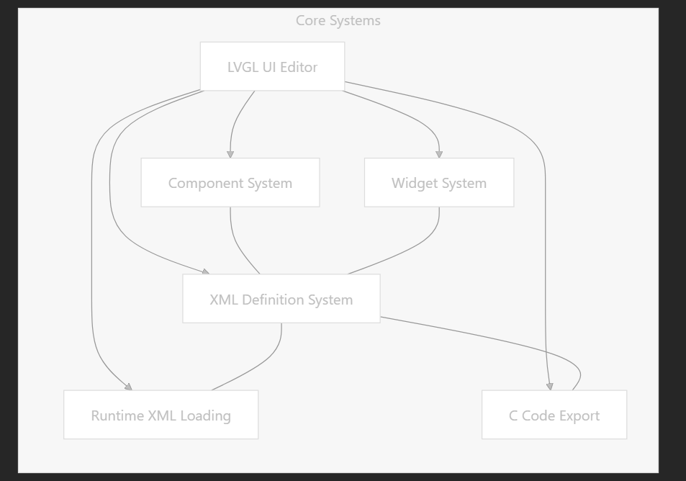
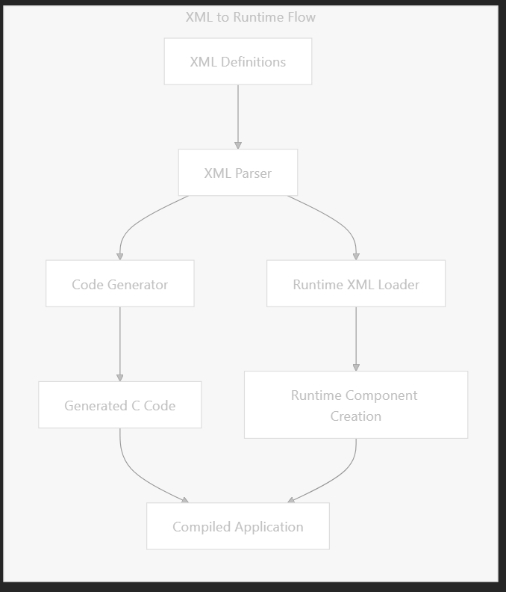
High-Level Architecture & Code Generation Pipeline
Compile-time integration: XML components are exported to C code for inclusion in the build
Runtime loading: XML definitions can be loaded directly at runtime without recompilation

Slide 13
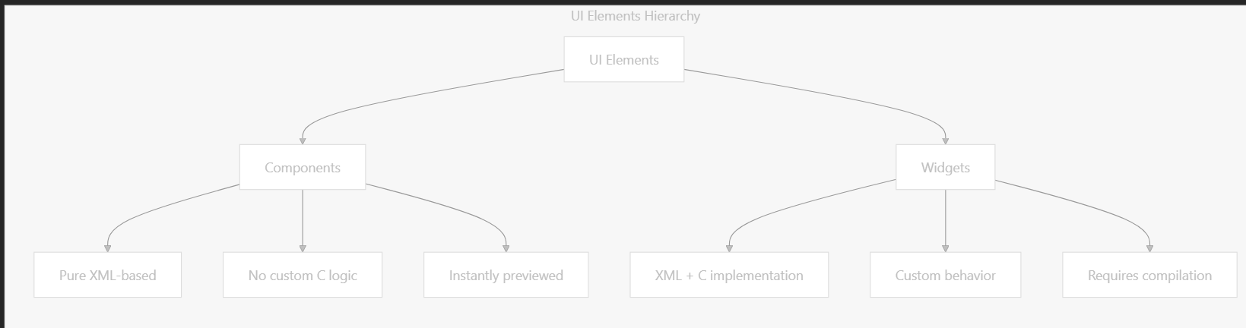
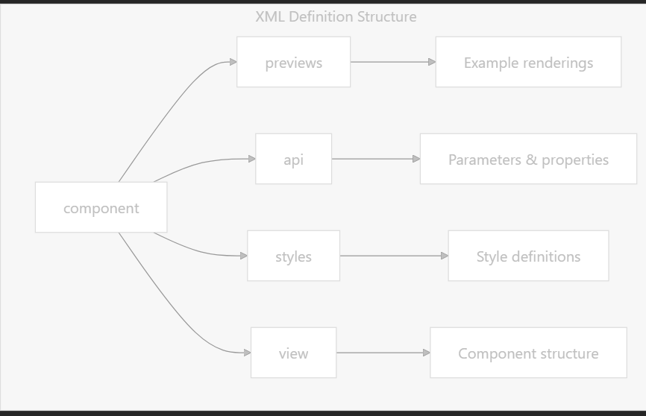
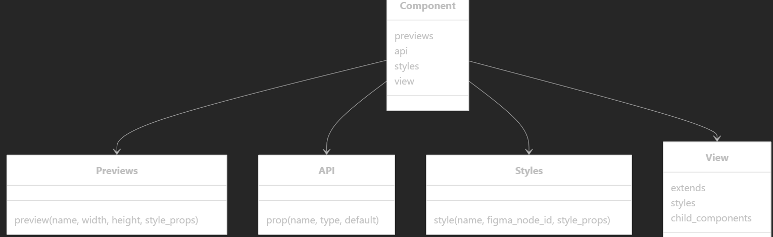
Component vs. Widget System & XML Definition Architecture

Slide 14
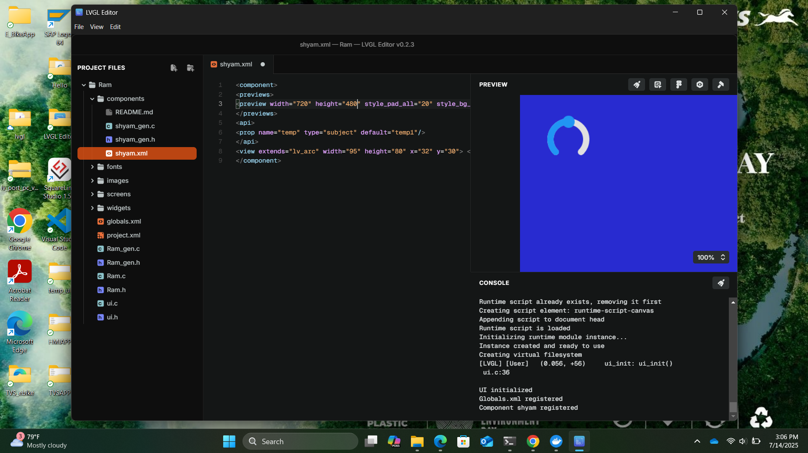
LVGL EDITOR DEMO

Slide 15
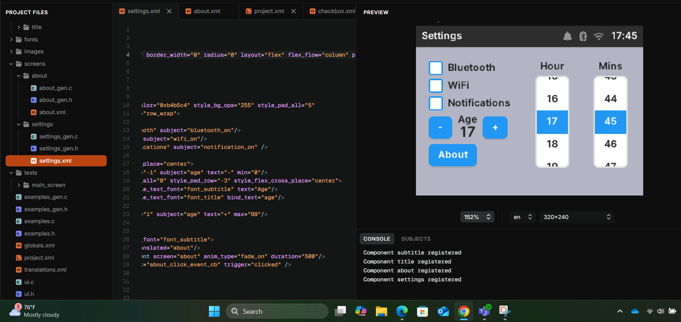
DEMO

Slide 16
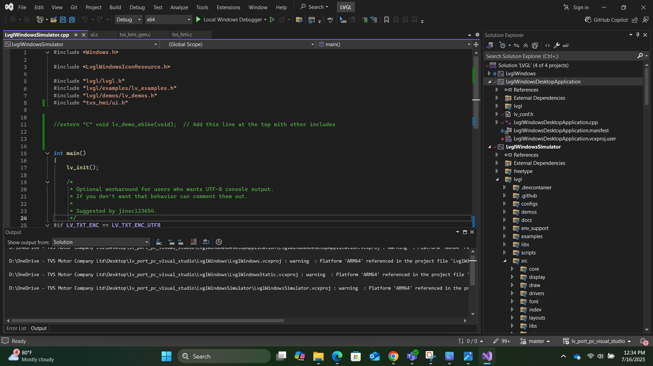
VISUAL STUDIO 2022 (SIMULATOR)

Slide 17
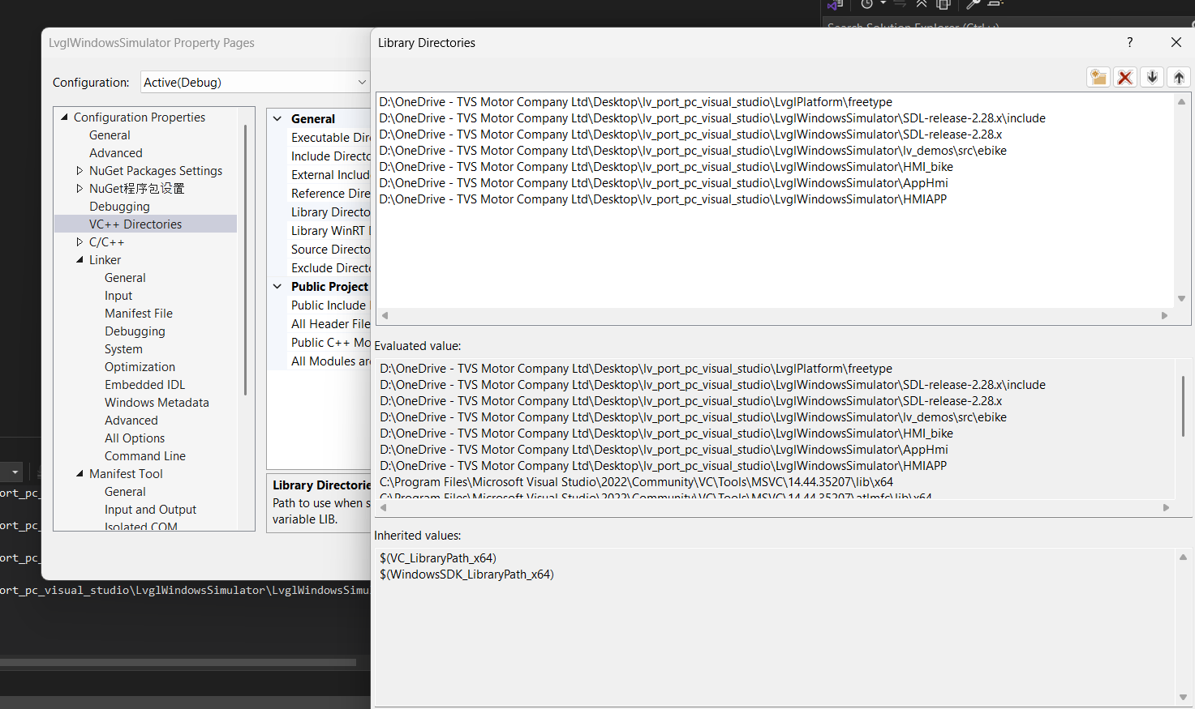
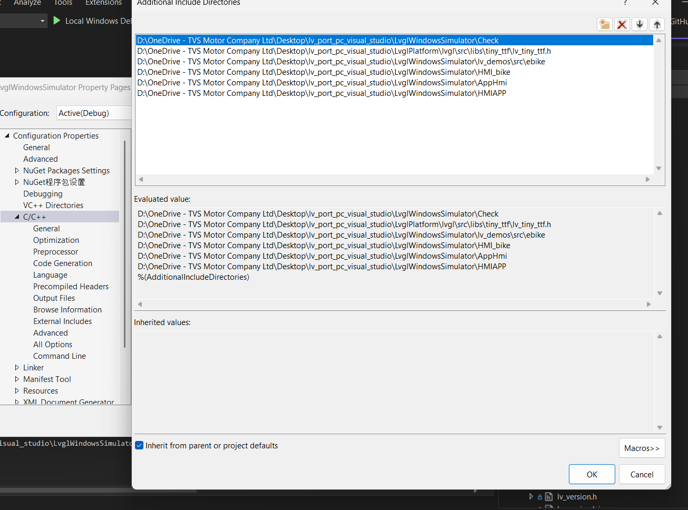
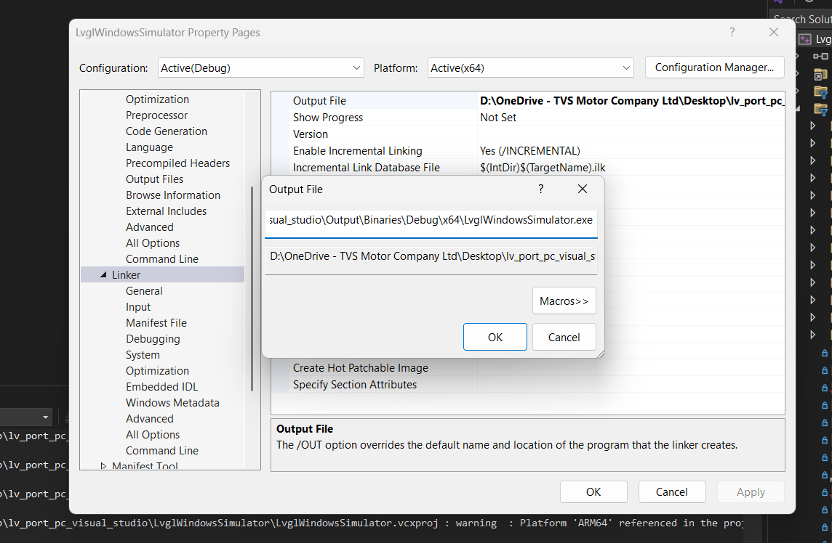
VS Configuration (Set A Path)

Slide 18
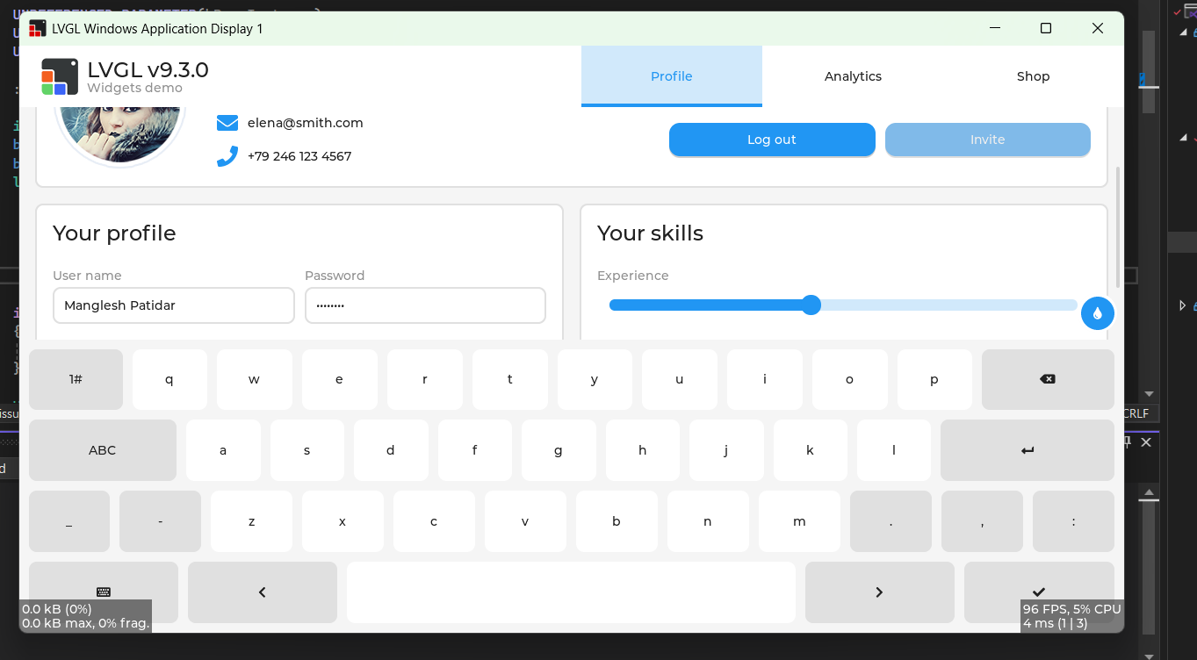
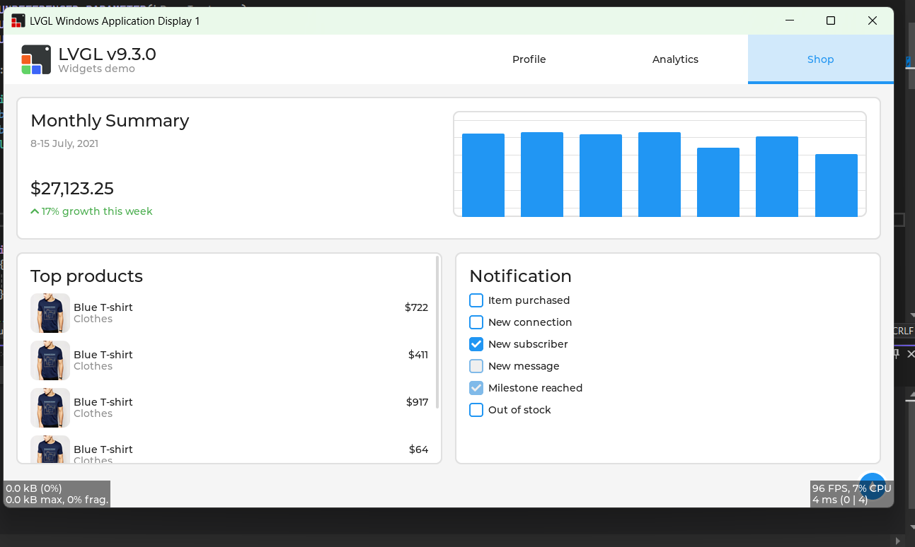
DEMO PROJECT

Slide 19
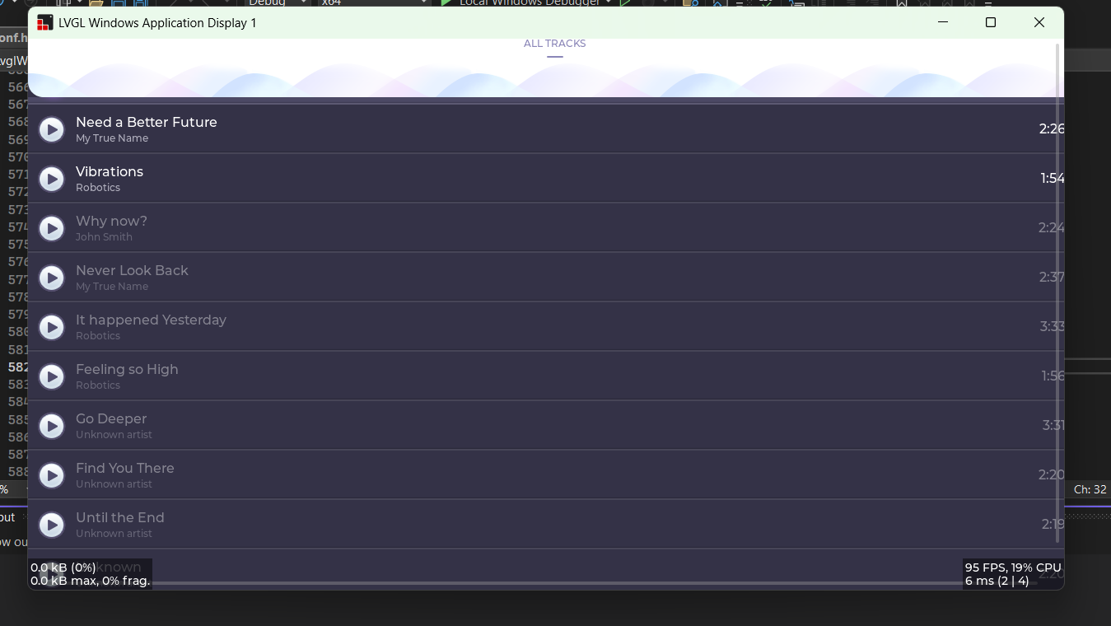
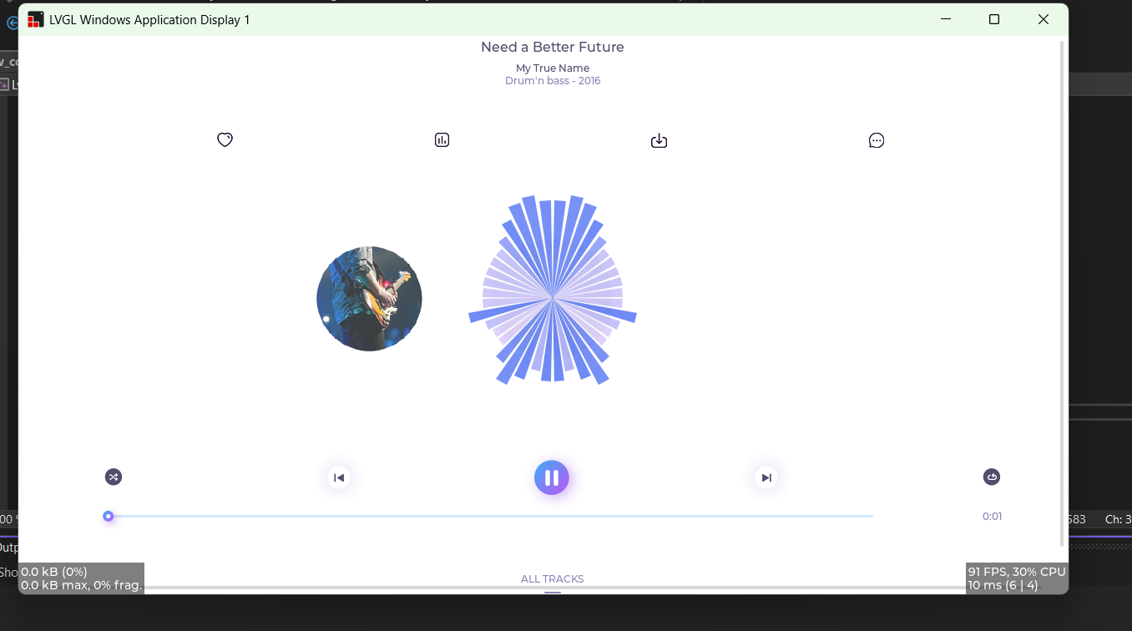
DEMO MUSIC

Slide 20
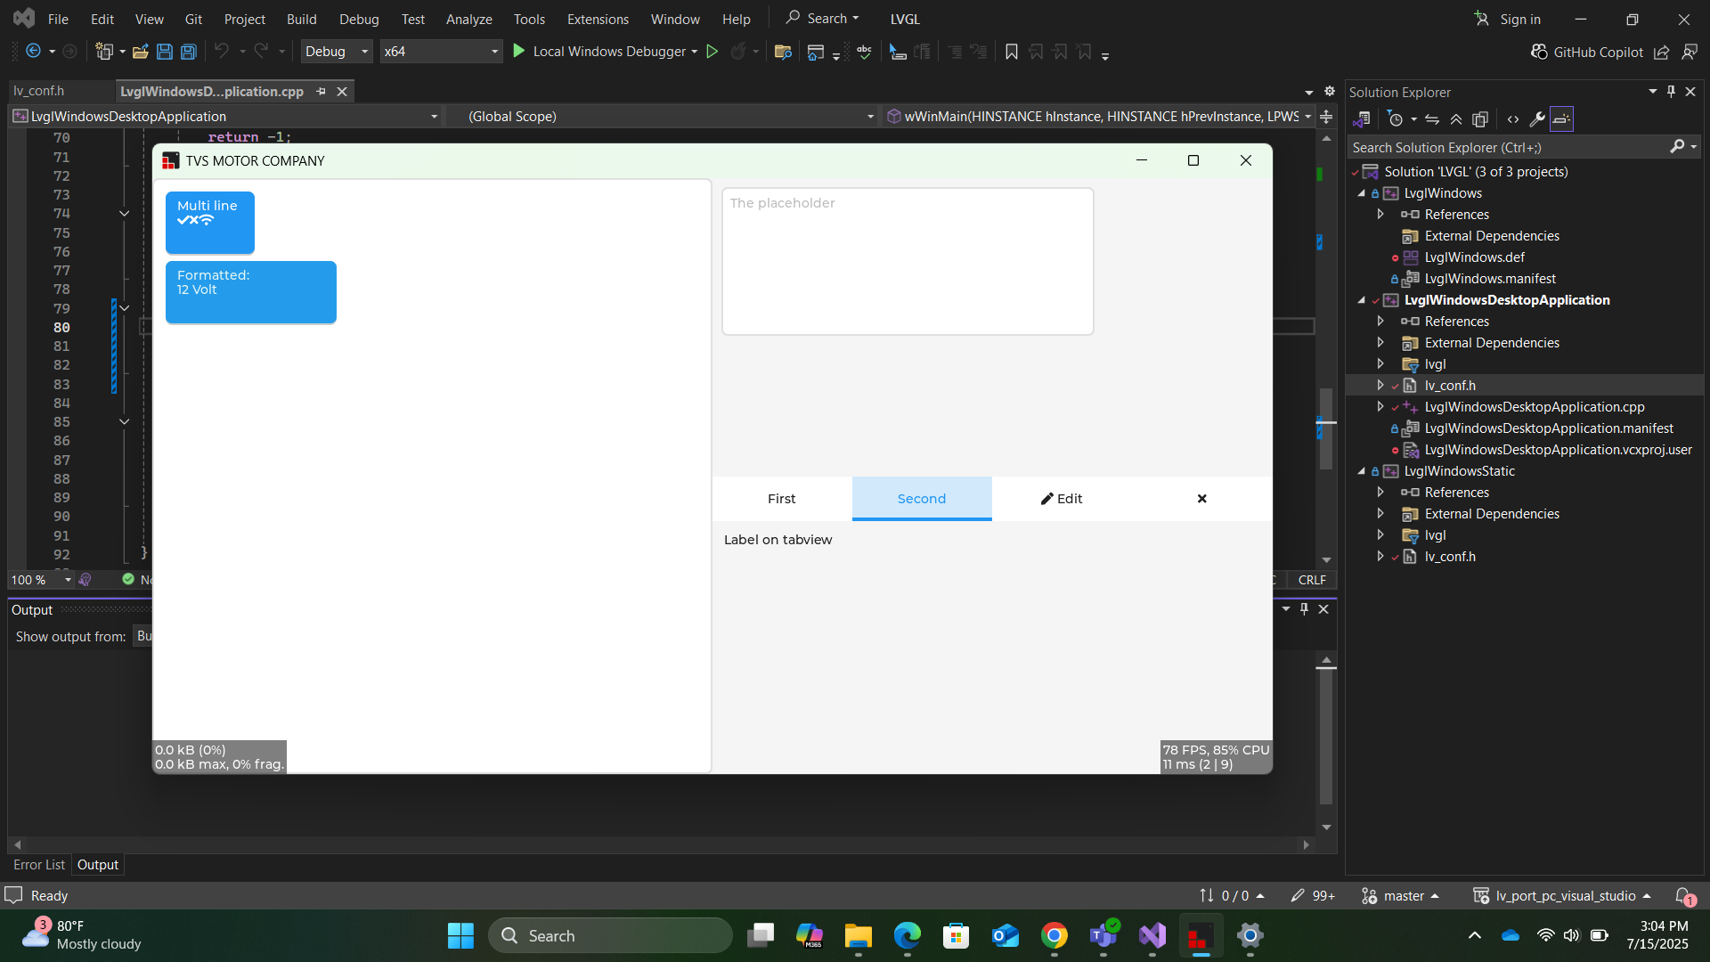
DEMO

Slide 21
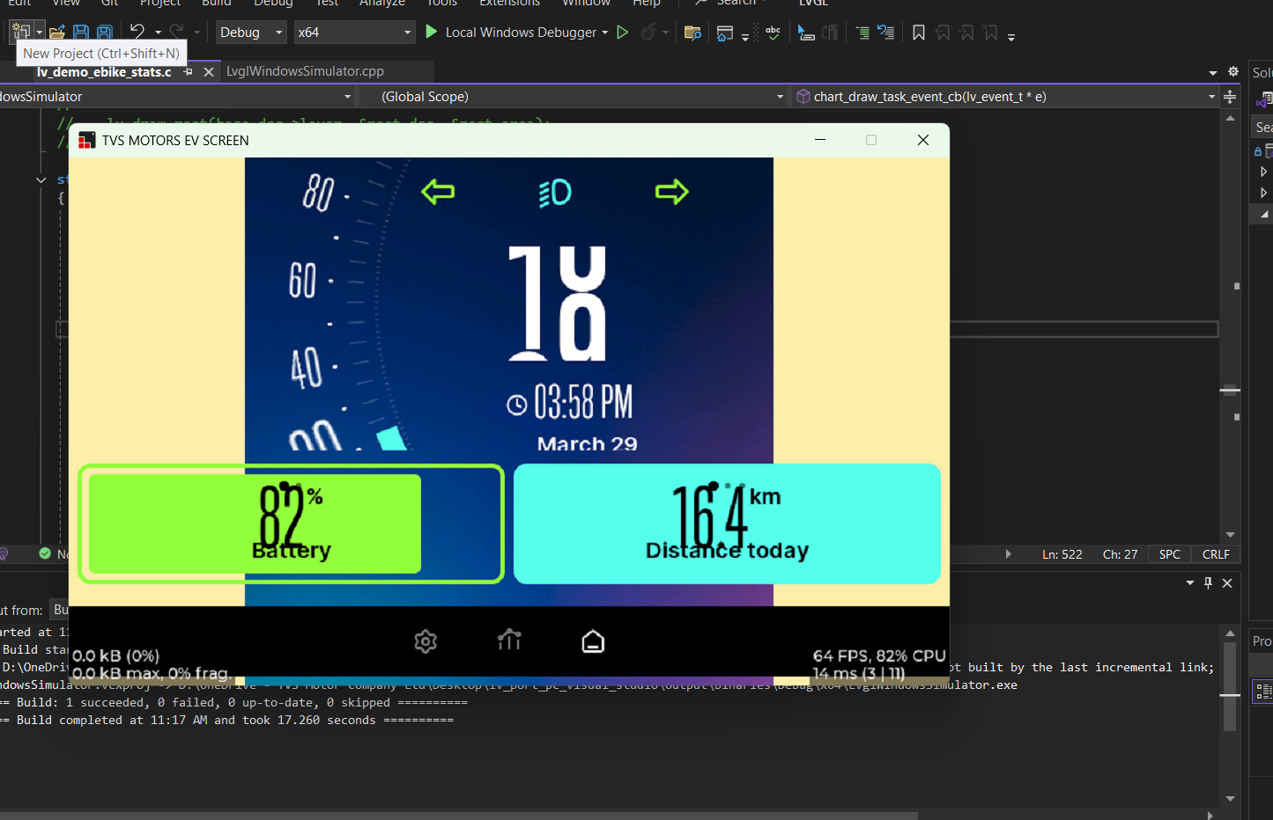
EBIKE (RUN ON SIMULATOR)

Slide 22
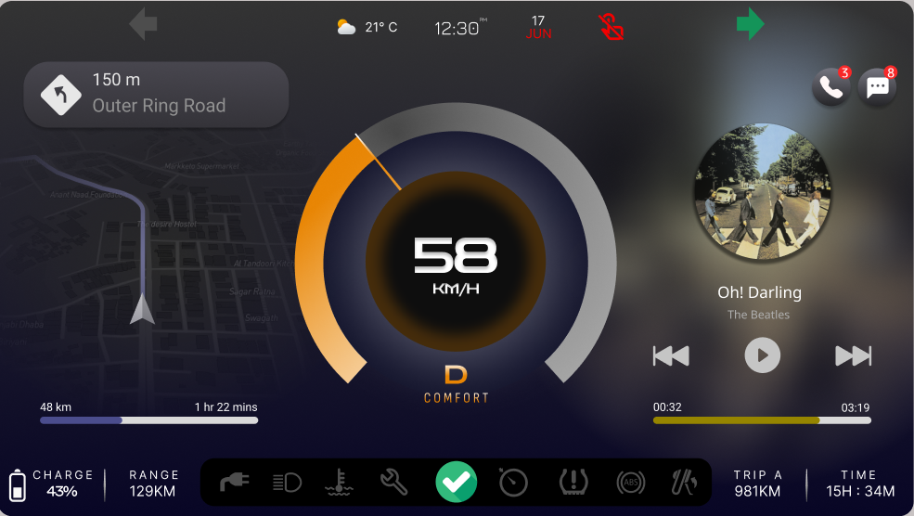
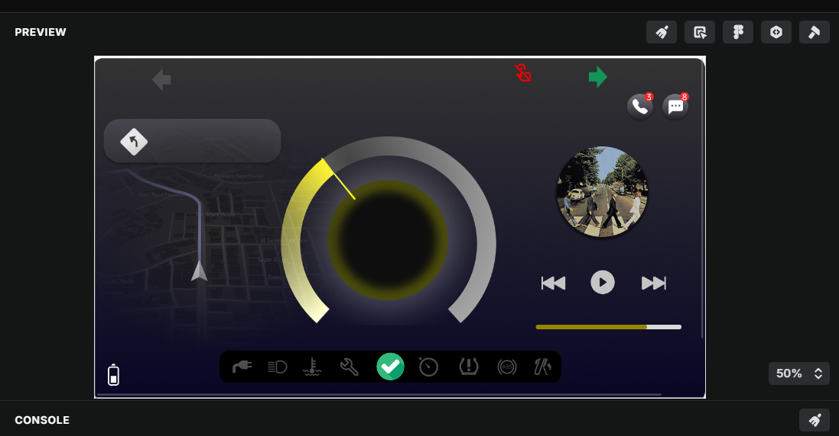
FIGMA --> LVGL EDITOR

Slide 23
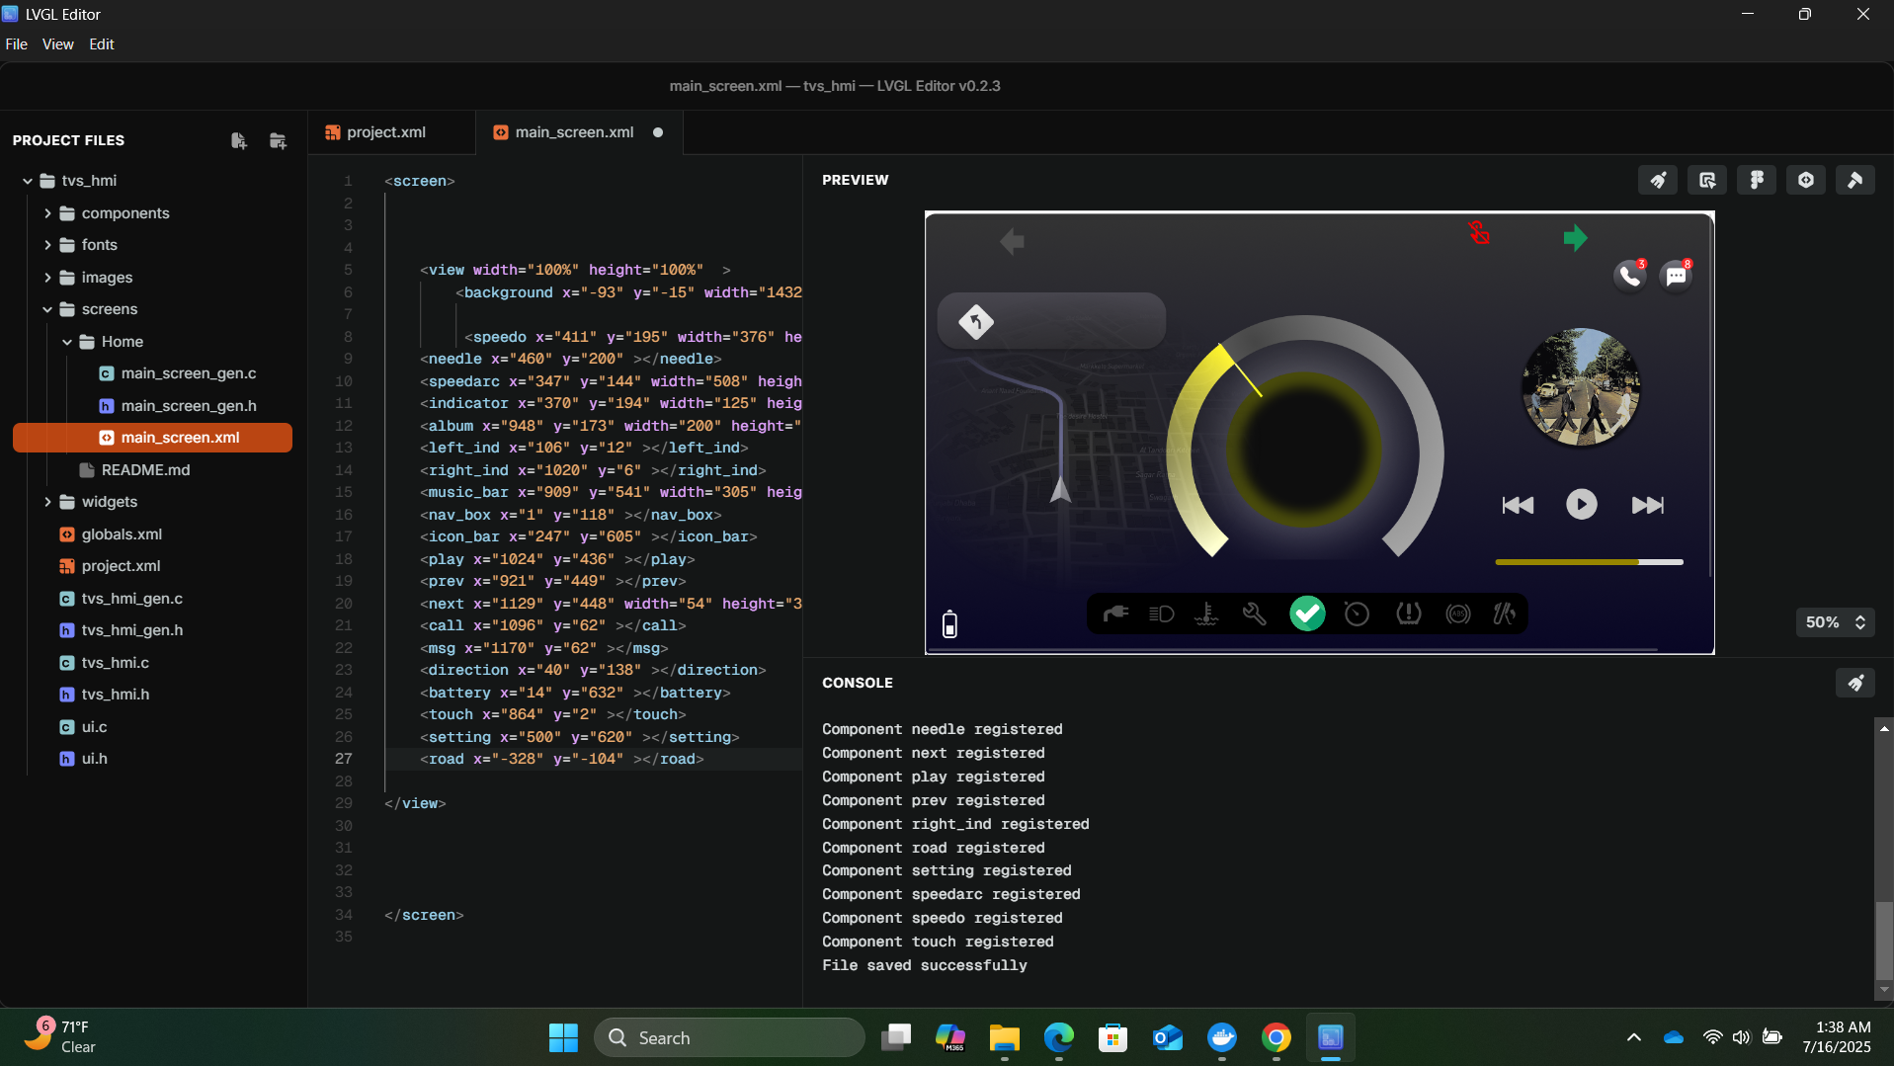
PROJECT TVS_HMI_EBIKE

Slide 24
FUTURE WORK & NEXT STEPS
Due to time constraints, this project was limited to developing and simulating the HMI using the LVGL UI Editor and running it on a PC-based simulator. Given additional time, the next critical milestone would be porting and deploying the LVGL-based HMI onto actual embedded hardware. This step involves integrating the UI with real-world inputs such as sensors, buttons, and communication protocols used in electric two-wheelers.
Key hardware platforms that can be used to run the HMI include:
NXP i.MX RT1050/1060 or RT1170 (high-performance crossover MCUs with display support)
STM32F7 / STM32H7 series (widely used in automotive and HMI applications)
ESP32-S3 (low-cost, Wi-Fi/Bluetooth-enabled MCU with LCD support)
Raspberry Pi 4 or CM4 (Linux-based option for rapid prototyping)
RK3566 / RK3399 SoCs (for Android/Linux-based rich HMI systems)
The future scope includes interfacing with sensors like speed, battery level, GPS modules, and Bluetooth; optimizing the UI for real-time performance; and deploying the solution on a touch display for a fully functional EV bike dashboard.

Slide 25
REFERENCES
https://lvgl.io/
https://lvgl.io/demos
https://docs.lvgl.io/master/intro/introduction/index.html
https://github.com/lvgl
https://github.com/lvgl/lvgl
https://github.com/lvgl/lv_port_pc_visual_studio
https://www.youtube.com/watch?v=gCxBAK9EByA
XML Structure and Syntax | lvgl/lvgl_editor | DeepWiki
Simulator on PC — LVGL documentation
https://github.com/libsdl-org/SDL

Slide 26
THANK YOU

